Slide 1

Political Ideology
Hasan Muhammad Baniamin

Slide 2
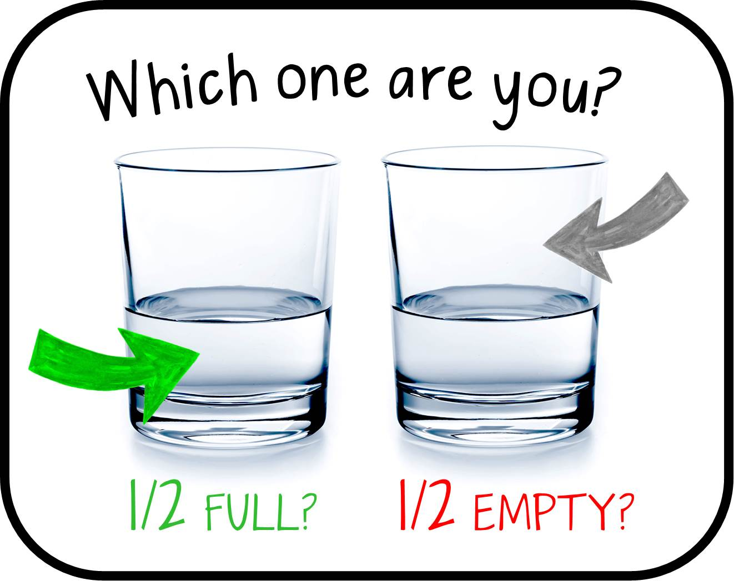

Slide 3
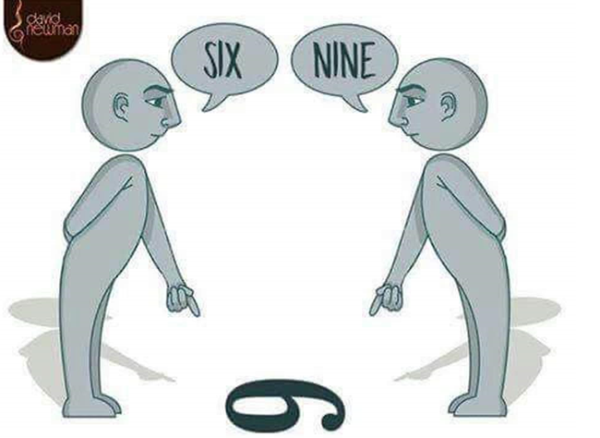

Slide 4
Political ideology
Political ideology is a comprehensive set of beliefs about the political world—about desirable political goals and the best ways to achieve those goals.
There are three main concerns for a political ideology:
  (1) individual human nature- “nature versus nurture”.
  (2) the proper relationship among the individual, state, and
  society- maximize individual liberty and freedom of action vs individual freedom must be constrained by the state.
  (3) the desirability of establishing equality among individuals – legal equality vs material equality.

Slide 5
Types of political ideology in the west
Conservatism
Classical liberalism
Socialism

Slide 6
Conservatism
Conservatism attempts to prevent or slow the transition away from a society based on traditional values and the existing social hierarchy.
Particular importance is placed on stability, tradition, and loyalty to God and country.
The Individual-
Conservatism makes two key assumptions.
  First, individuals are not consistently rational, in many situations, people are emotional and are unable to reason clearly. Thus, tradition and religion, rather than reason,
  are viewed as the most reliable sources for guiding society.
  Second, individuals are inherently unequal in intelligence, skills, and status. Some individuals and groups are superior to others

Slide 7
Conservatism
Individual, State, and Society-
  Traditional values and ethics provide the guidelines for group cooperation as well as individual behavior.
  Government should use its power to maintain social order; to preserve traditional values, especially regarding family life, religion, and culture; and to protect private property rights.
  State military and economic power should also promote the country’s interests abroad and defend
  against intervention by other states.

Slide 8
Conservatism
Equality
  Because inequality is a natural aspect of society, it is foolish and even dangerous to seek egalitarianism.
  Forced equality is unwise because it disrupts the
  natural, cooperative hierarchy among groups, causes social conflict, and endangers the fundamental goal of order and stability.

Slide 9
Classical liberalism
The ideology of classical liberalism places the highest value on individual freedom and posits that the role of government should be quite limited.
The individual-
  Each person is rational and has the ability to use reason to determine the sensible rules (the “laws of nature”) that shape how she should live in
  pursuit of her own needs and without harming others.

Slide 10
Classical liberalism
Classical liberalism contrasts with conservatism in several important ways:
  (1) the freedom of each individual to pursue her natural rights is the highest value; and
  (2) each individual is rational and responsible and is the best judge of what is in her self-interest.

Slide 11
Classical liberalism
Individual, State, and Society
  A person’s full capabilities can be realized only if she is not limited by a conservative social order in which tradition and hierarchy are dominant.
  The state should mainly be a night watchman, a low-profile police officer who ensures the basic safety and freedom of every individual.

Slide 12
Classical liberalism
Equality
  Equality before the law (equality of opportunity) is important, but government should not attempt to create material equality (equality of outcomes).
  People pursue their interests in different ways and with different levels of success.

Slide 13
Socialism
For socialism, the most important goal is to provide high-quality, relatively equal conditions of life for everyone, with an active state assisting in the achievement of this goal.
Socialism evolved as a distinctive ideology among theorists concerned about the plight of people who had relatively little economic, social, or political power.

Slide 14
Socialism
The Individual
  In the socialist perspective, people are social and caring by nature.
  They are not innately selfish and aggressive, although negative social conditions can produce such behavior.
  Thus, it is crucial to create an environment that encourages individuals to place the highest value on cooperation and sharing.

Slide 15
Socialism
Individual, State, and Society
  Because the good of the society as a whole is
  the most important goal, some of an individual’s interests must be subordinated to, or at least coordinated with, the overall interests and needs of everyone in the society.
  The state is also much more active in controlling powerful actors and self-interested groups whose
  behavior will harm the collective good of the society

Slide 16
Socialism
Equality
  The ideology of socialism centers in a deep commitment to use the power and policies of the state to increase the material, social, and political equality of all its members.

Slide 17
Different ‘isms’
Anarchism— there is an absence of organized government.
Authoritarianism—a system in which the political rights and interests of individuals are subordinated, usually by coercion, to the interests of the state.
Conservatism—a belief in the virtue of preserving traditional values and social institutions and of promoting loyalty to country, reliance on family, and adherence to religion.

Slide 18
Different ‘isms’
Corporatism—a political economy in which there is extensive economic cooperation between an activist state and a few groups that represent major economic actors such as large industry, organized labor, and farmers.
Environmentalism—advocacy of the planned management of a natural resource or of the total environment of a particular ecosystem to prevent exploitation, pollution, destruction, or depletion of valuable natural
resources.
Fascism—a system in which the unity and harmony of government and society are of central importance and forces that might weaken that unity are repressed; a top leader is usually viewed as the embodiment of
the natural will, and all individuals are expected to obey the leader’s will.

Slide 19
Different ‘isms’
Feminism—a diverse social movement promoting equal rights and opportunities for women and men in their personal lives, economic activities, and politics.
Totalitarianism—a system in which the state possesses total control over all aspects of people’s lives, including their economic, social, political, and personal spheres.
Pacifism—a belief that the highest political and social value is peace and the absence of violence.
Marxism—a set of ideas based on the writings of Karl Marx, who argued that society is composed of competing classes based on economic power, that class struggle and change are inevitable, and that the desired goal is the equal distribution of welfare in the society.

Slide 20
Suggested readings
Danziger, J. N., & Smith, C. A. (2016). Understanding the political world: A comparative introduction to political science. Boston :Pearson, pp. 30-39.

Slide 21
Q?

